Slide 1
Java Lang Package

Slide 2

Learning Objectives Exception
Object class
String
String Buffer & String Builder
Wrapper classes
Autoboxing and Unboxing

Slide 3
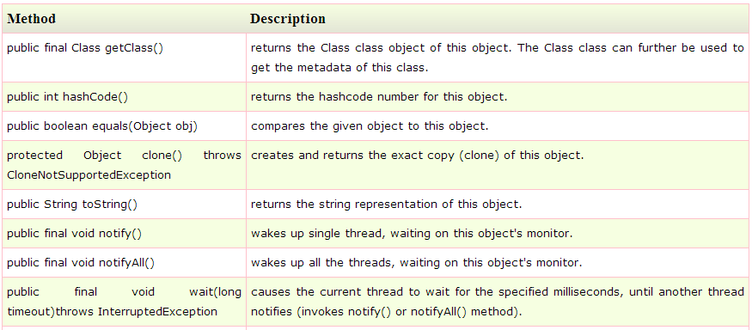
Object Class
The Object class is the parent class of all the classes in java by default. In other words, it is the topmost class of java.
Methods Of Object

Slide 4
String Class & Methods
The java.lang.String class provides a lot of methods to work on string. We can perform operations on string such as trimming, concatenating, converting, comparing, replacing strings etc. String Class are Immutable which once created it’s property and behavior cannot be changed
Methods
CharAt()
equalsIgnoreCase()
length()
replace()
substring()
toLowerCase()

Slide 5
String Class & Methods Contd.
toUpperCase()
trim()
valueOf()
toString()
indexOf()
lastIndexOf()

Slide 6
String Buffer
StringBuffer class is used to create a mutable string object. It represents growable and writable character sequence. It is also thread safe i.e multiple threads cannot access it simultaneously.
Methods of StringBuffer
append()
insert() → StringBuffer insert(int index, String str)
reverse()
capacity()
ensureCapacity()

Slide 7
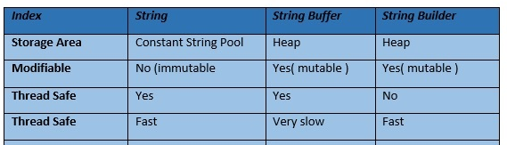
String Builder
Java StringBuilder class is used to create mutable (modifiable) string. The Java StringBuilder class is same as StringBuffer class except that it is non-synchronized (Not Thread Safe)

Slide 8
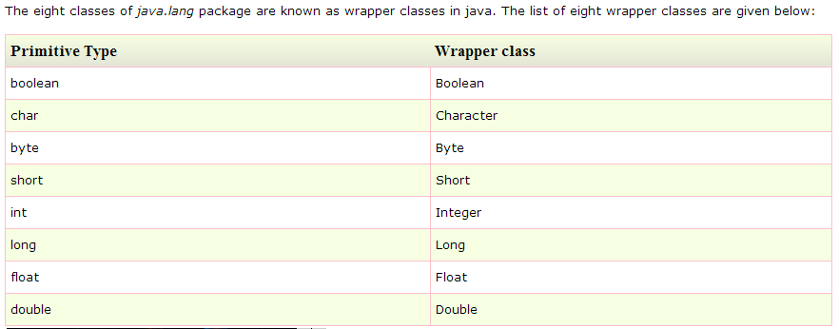
Wrapper Classes
Wrapper class in java provides the mechanism to convert primitive into object and object into primitive.

Slide 9
Autoboxing and Unboxing
Autoboxing and Unboxing feature converts primitive into object and object into primitive automatically. The automatic conversion of primitive into object is known as Autoboxing and vice-versa Unboxing.
Example: Primitive to Wrapper
int a=20;
Integer i=Integer.valueOf(a);//converting int into Integer
Integer j=a;//autoboxing, now compiler will write Integer.valueOf(a) internally
Example: Wrapper to Primitive
Integer a=new Integer(3);
int i=a.intValue();//converting Integer to int
int j=a;//unboxing, now compiler will write a.intValue() internally

Slide 10
What are we learning in Next Chapter ?
Java Reflection
java.lang.Class
java.lang.reflect.Field
java.lang.reflect.Method
java.lang.reflect.Constructor
java.lang.reflect.Modifier

Slide 11
Thank You !

